Slide 1
CS242 Project – Winter 2023
Presented By Jannat Ara Meem
Additional thanks to Shihab Rashid, Merlin Mao, Nhat Le, Mohiuddin Abdul Qader, Waleed Amjad, Matthew Wiley, Shiwen Cheng and Eduardo Ruiz for some slides

Slide 2
Agenda
Project overview
Crawler resources
Indexing
Query Interface

Slide 3
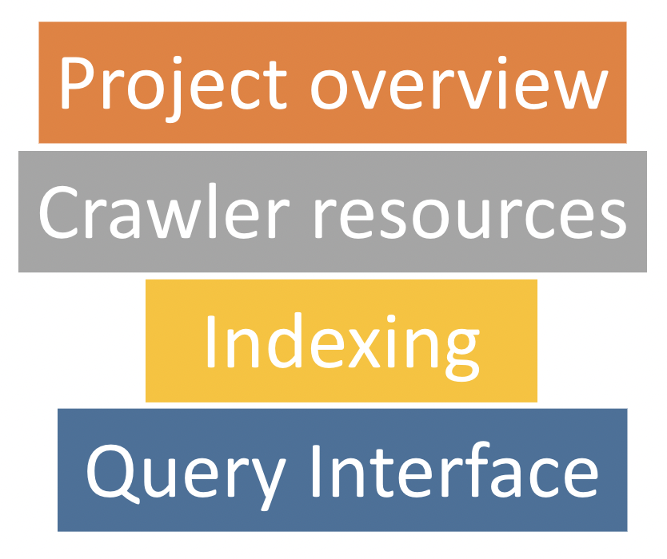
Agenda
Part A
Sparse (using PyLucene or PyElasticSearch)
Dense (using BERT)
Part B

Slide 4
Project Overview – Part A – Feb 13
at least 500MB data, how many items?
Architecture
Crawling Strategy
Difficulties & Solutions, Limitation
Instructions for Usage
Crawler
Index Fields -> why?
Text Analyzer Choices
Run time of index construction
Limitations
Instructions for Usage
PyLucene

Slide 5
Project Overview – Part B – Mar 17
Generate dense embeddings using BERT
Index and search using the dense embeddings
BERT
Details will be discussed in the next TA lecture
Web UI

Slide 6
Crawling resources
Webpages:
Scrapy
https://docs.scrapy.org/en/latest/index.html
Jsoup/BeautifulSoup
https://jsoup.org/
https://beautiful-soup-4.readthedocs.io/en/latest/
Or anything else similar, just not a full crawler
Twitter: Tweepy
Twitter streaming/search API
https://docs.tweepy.org/en/stable/

Slide 7
Crawling webpages
getNext
Download contents of page
1
Frontier
www.cs.ucr.edu
www.cs.ucr.edu/~vagelis
Parse the downloaded file
to extract links the page
2
getNext()
Clean and Normalize the extracted links
Add(List<URLs>)
3
addAll(List)
Store extracted links in the
Frontier
4

Slide 8
Crawling webpages
How many pages in total to craw?
Limit per domain, per category, or global limit
Depth of links: How deep to go?
Page A -> Page B -> Page C -> …
Duplicate pages:
how to detect?
Page A -> Page B -> Page C -> Page A

Slide 9
Crawling webpages
How many pages in total to craw?
Limit per domain, per category, or global limit
Depth of links: How deep to go?
Page A -> Page B -> Page C -> …
Duplicate pages:
how to detect?
Page A -> Page B -> Page C -> Page A
and remove?
Page A -> Page B -> Page C -> Page A

Slide 10
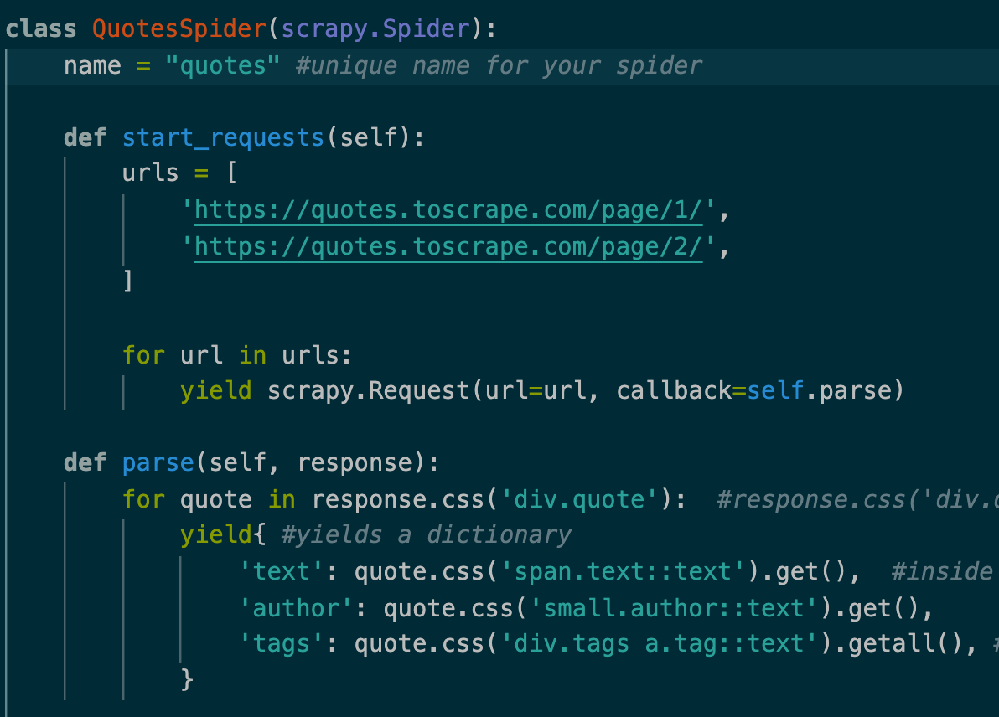
Crawling webpages - Scrapy
https://docs.scrapy.org/en/latest/index.html
Create your first Spider: Scrapy uses Spiders to scrape information from a website
parse() response:
extract the scraped data using css selectors as dicts (https://docs.scrapy.org/en/latest/topics/selectors.html)
parse the response (downloaded page/data)

Slide 11
Crawling webpages - Scrapy
Run the Spider and store the scraped data
Go to project’s top level directory
Run command: scrapy crawl crawlerName -o data.jsonl
You can later read the json file as a list of dictionaries using the following command:
with open('data.jsonl', 'r') as file:
json_data = [json.loads(line) for line in file]

Slide 12
Crawler Ethics
Some websites don’t want crawlers swarming all over them.
Why?
Increases load on the server
Private websites
…
How does the website tell you (crawler) if and what is off limits.
Two options
Site wide restrictions: robots.txt
Webpage specific restrictions: Meta tag

Slide 13
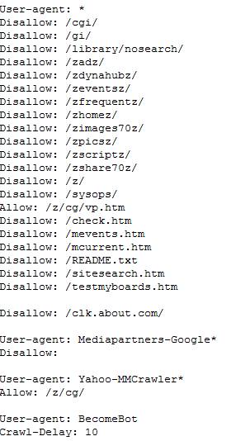
Crawler Ethics robots.txt
A file called “robots.txt” in the root directory of the website
Example: http://www.about.com/robots.txt
Format:
User-Agent: <Crawler name>
Disallow: <don’t follow path>
Allow: <can-follow-paths>

Slide 14
Crawler Ethics Website Specific: Meta tags
Some webpages have one of the following meta-tag entries:
<META NAME="ROBOTS" CONTENT="NOINDEX, FOLLOW">
<META NAME="ROBOTS" CONTENT="INDEX, NOFOLLOW">
<META NAME="ROBOTS" CONTENT="NOINDEX, NOFOLLOW">
Options:
INDEX or NOINDEX
NOINDEX: Ask search engines to not index this page
FOLLOW or NOFOLLOW
NOFOLLOW: Ask the search engines to not follow the indicated link

Slide 15
Twitter data collecting
Twitter Streaming API (v2)
The Streaming API provides low-latency access to Tweets.
Main doc:
https://developer.twitter.com/en/docs/tweets/filter-realtime/overview
https://developer.twitter.com/en/docs/tutorials/consuming-streaming-data.html
https://developer.twitter.com/en/docs/tweets/data-dictionary/overview/intro-to-tweet-json
Able to get several millions tweet per day.
Store tweets in large JSON files
Note: If a single file is too big, it’s ok to split it into several smaller files. However, it’s not a good idea to have too many files, for example, one tweet in one file.
Twitter’s search API has similar usage with a much more strict rate limit

Slide 16
Twitter Streaming API – 3rd-party libraries
Easier to use
Python: Tweepy
NodeJS: twit
And many others
Java: Twitter4j
Well documented and code examples.
Support OAuth via config file, configuration builder, system properties and environment variables.

Slide 17
Tweepy (https://docs.tweepy.org/en/stable/index.html)
Run the following command to install tweepy: pip3 install tweepy
Create a Twitter developer account from here.
While signing up, request for elevated access so that you can get access to more tweets and APIs for scraping.
Then go to the developer portal and create a project.
You will get a few tokens when you create the project: API(consumer) key, API(consumer) key secret, Bearer token, Access token, Access token secret
Twitter requires all requests to use OAuth for authentication. You will need these tokens to establish OAuth authentication.
Example code: auth = tweepy.OAuth1UserHandler(
consumer_key, consumer_secret, access_token, access_token_secret
) api = tweepy.API(auth, wait_on_rate_limit=True) The API class provides access to the entire twitter RESTful API methods. Each method can accept various parameters and return responses.

Slide 18
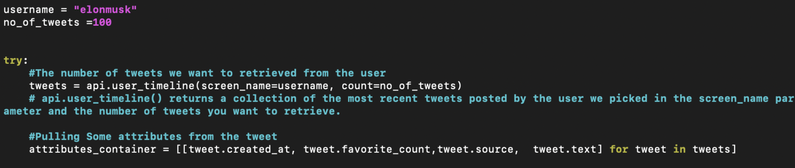
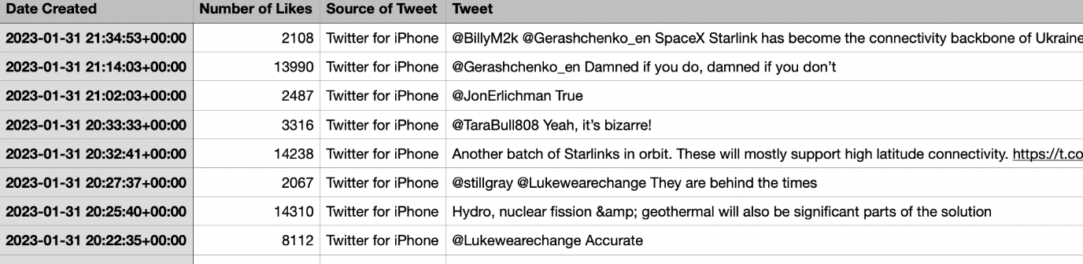
Tweepy Example(1)
Output:

Slide 19
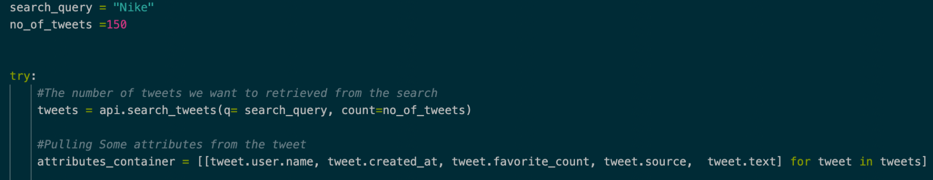
Tweepy Example(2)
Refer to https://docs.tweepy.org/en/stable/api.html for more information on API methods.

Slide 20
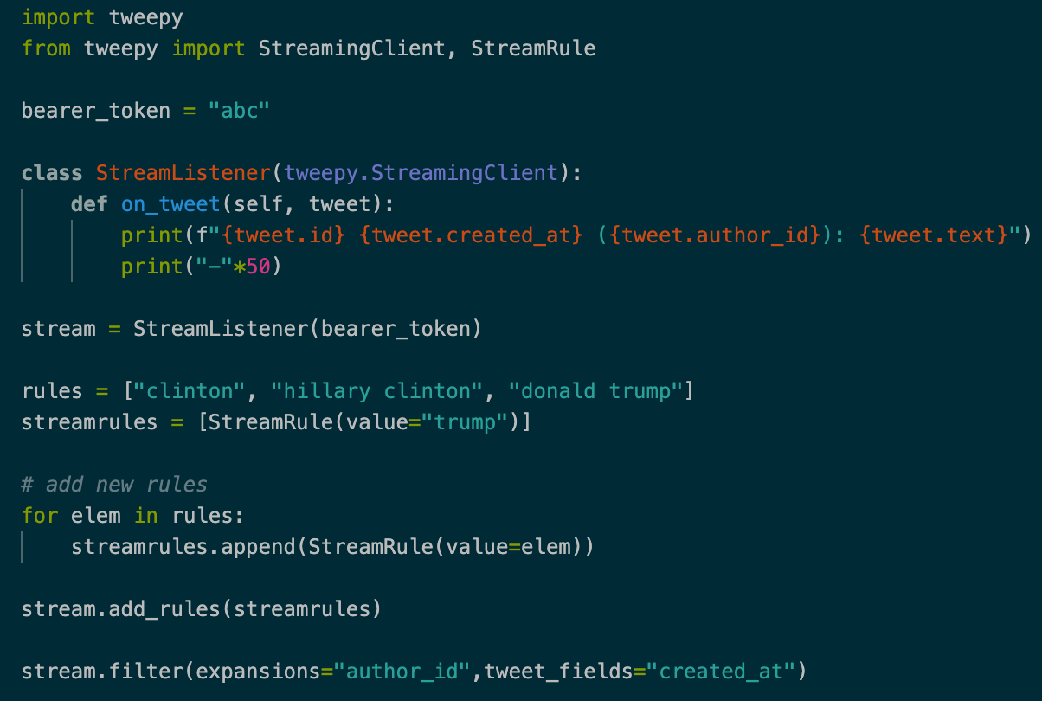
Streaming with Tweepy (Twitter API v2)

Slide 21
Streaming with Tweepy (Twitter API v2)
Refer to https://docs.tweepy.org/en/stable/streamingclient.html for more information on StreamingClient (filter, expansions etc.)
The example code is taken from link
Note: the more complex filtering you impose, the slower the stream.

Slide 22
Important Fields
At least following fields you should save:
Text
Timestamp
Geolocation
User of the tweet
Links
Hashtag

Slide 23
Last words about crawler
You can crawl Instagram/reddit/pinterest etc. too if you like.
Don’t forget to mention in bold what you have done extra to get bonus points.
Multi-threading
Duplicate page handling etc.
Efficient downloading of the links in tweets.
Etc.

Slide 24

Sparse Indexing and Query Search
https://lucene.apache.org/pylucene/
Only use the PyLucene (or PyElasticSearch), Solr is not acceptable
Note: you may also use Java (Lucene) if you prefer but you have to figure out how to make the Web app work if you choose to do a Web app

Slide 25
PyLucene
Apache LuceneTM is a high-performance, full-featured text search engine library written entirely in Java. PyLucene is a Python extension for accessing Java Lucene.
Suitable for nearly any application that requires full-text search, especially cross-platform.
Multiple-index
Ranked searching -- best results returned first
Query parser
Fast and efficient
Already installed on the server PC assigned to you!

Slide 26
PyLucene in a search system
Users
Index document
Analyze document
Search UI
Index
Build document
Build query
Render results
Acquire content
Raw Content
Run query

Slide 27
PyLucene – An Information Retrieval Library
Documents
E.g., a webpage, tweet
Fields
Webpage: Title, Content, URL, Metadata, …
Tweets: Content, Hashtags, URL, Location, Time, …
Images: Name, Alternate Text, URL, …
Indexing:
Index document from data
Call IndexWriter
Searching:
Create query, search with created index.
Call IndexSearcher

Slide 28
PyLucene – Field
Most general class at: org.apache.lucene.document.field
– For Expert: directly create a field for a document.
import org.apache.lucene.document.Field
Field(String name, String value, IndexableFieldType type)
value can also be specified with a Reader, a TokenStream, or a byte[]
Refer to https://lucene.apache.org/core/7_7_1/core/org/apache/lucene/document/FieldType.html for more details.

Slide 29
PyLucene – Field
Field(String name, String value, IndexableFieldType type)
• Fields may (via IndexableFieldType)
– Be indexed or not
• Indexed fields may or may not be analyzed (i.e., tokenized with an Analyzer)
– Non-analyzed fields are viewed as a single token (useful for URLs, paths, dates, social security numbers, ...)
– Be stored or not
• Useful for fields that you’d like to display to users
– Optionally store term vectors (via IndexOptions)
• Like a positional index on the Field’s terms
• Useful for highlighting, finding similar documents, categorization

Slide 30
Field options – Different design choices
Indexed | Stored | Example
No | No | Not relevant for searching
Yes, Not Tokenized | Yes | Twitter username
Yes, Not Tokenized | No | Sensitive information
Yes, Tokenized | Yes | Title, abstract
Yes, Tokenized | No | Body

Slide 31
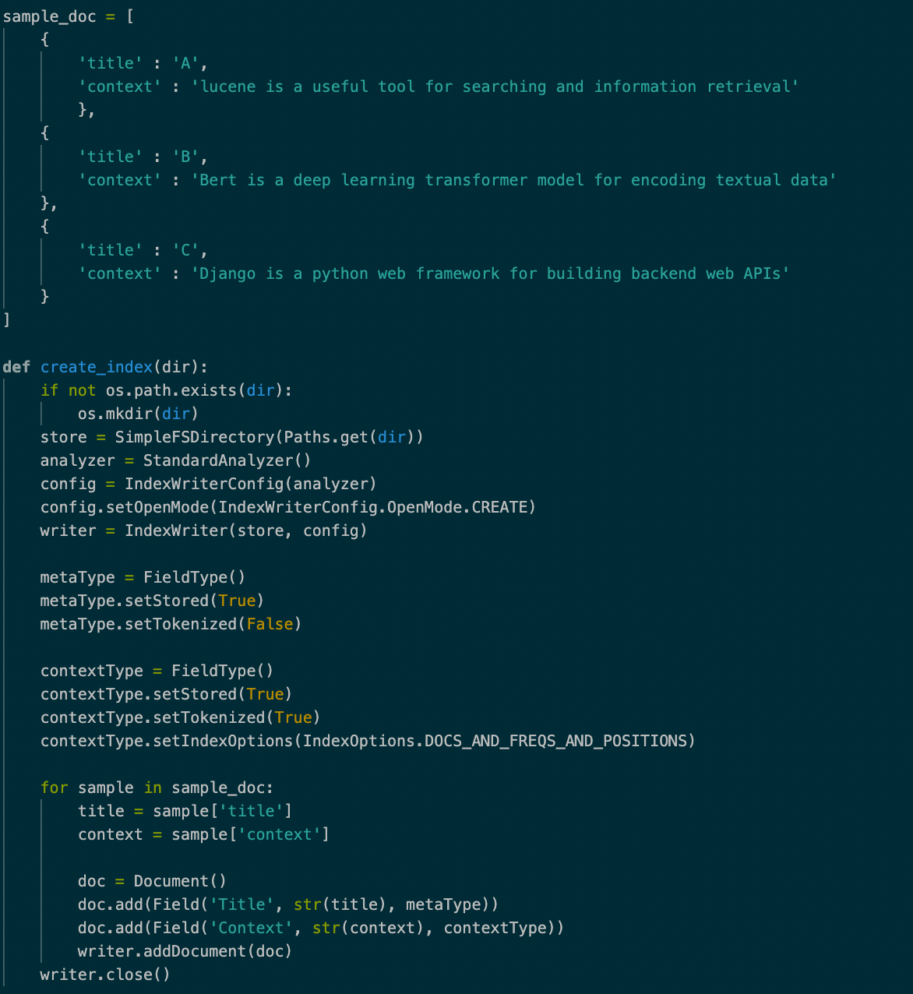
Analyzer:
Controls tokenization, stemming, and stop words
StandardAnalyzer Sufficient in most cases
Directory: where to save index
SimpleFSDirectory
IndexWriter
Add Document
Note: Ability to store the original document?
Build Index

Slide 32
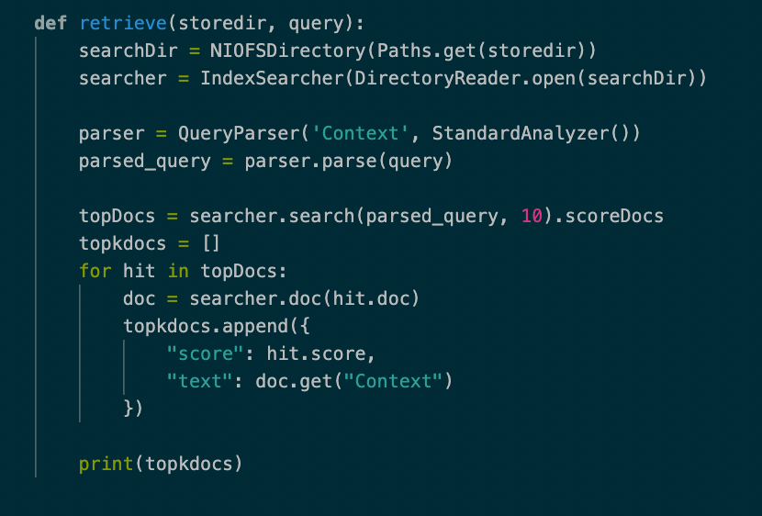
Read Index
QueryParser
Analyzer
IndexSearcher
Note: Ability to recover the original document?
Search and retrieve

Slide 33





Query Semantics
Basic Query:
Boolean queries:
Field/Term Boosting:
Proximity search
Range search
Wildcard search

Slide 34
PyLucene Scoring
Default is a variant of Tf-Idf scoring model
PyLucene also supports Vector Space Model, BM25, Language Models
http://lucene.apache.org/core/8_4_0/core/org/apache/lucene/search/similarities/package-summary.html
Custom scoring also available, subclass ClassicSimilarity

Slide 35
How to run a PyLucene code in bolt
ssh into bolt account “ssh netid@bolt.cs.ucr.edu”
Enter your bolt password
Type “cs242_login”
PyLucene is already installed in the server PC. So, you can create a python file and write your code there by running command “vim sample.py”
Then run “python3 sample.py” for running your code
You can also use Jupyter Lab to write and run your code

Slide 36
(Optional) How to install Jupyter Lab in bolt
Install Jupyter Lab using the following commands:
pip3 install jupyterlab
pip3 install markupsafe==2.0.1
Create a default config file
jupyter notebook --generate-config
Create a password. Your hashed password is stored in ~/.jupyter/jupyter_notebook_config.json
jupyter notebook password
Edit ~/.jupyter/jupyter_notebook_config.py, uncomment and edit the following settings: c.NotebookApp.ip = '*'
c.NotebookApp.open_browser = False
c.NotebookApp.password = 'your_hashed_password'
c.NotebookApp.port = 8888

Slide 37
(Optional) How to run Jupyter Lab in bolt
Run Jupyter Lab
jupyter lab --ip 0.0.0.0 --port 8888
Test in your browser: Visit
http://class-0XX.cs.ucr.edu:8888 (Replace “XX” with the class ID associated with your group. Visit link to find your class ID)
Login with your password in Jupyter Lab

Slide 38
Other details in PyLucene API
How to choose:
Fields
Analyzer
Scoring function
Index some fields, display original document in the query result

Slide 39
Copying files from server PC to local machine & vice versa
Use the “scp” command: “scp source destination” (Replace source & destination appropriately)
For copying files from your local machine to server PC:
First copy your file from personal computer to bolt
“scp <filepath>/filename netid@bolt.cs.ucr.edu:~/
After logging in using “cs242_login”, scp again
“scp netid@bolt.cs.ucr.edu:~/filename ~/”
For copying files from your server PC to local machine:
First login to server PC using “cs242_login” from bolt, then copy file from server PC to bolt:
“scp <filepath>/filename netid@bolt.cs.ucr.edu:~/”
Then copy file from bolt to local machine:
“scp netid@bolt.cs.ucr.edu:~/filename <filepath>/filename”

Slide 40
Make your project interesting
Support different types of ranking, search operator
PyLucene already supports a lot of ways to parse the query and customize search.
More suggestions can be borrowed from Google: https://ahrefs.com/blog/google-advanced-search-operators/?fbclid=IwAR05cn9KDnVdc3my20Xg1bh2e5eHwGDqGWDd_bXOT4tBdEYcxv1BFcjI81Y

Slide 41
Best advices?
Crawling takes up a good amount of time, so start early
Google, Google and Google
Stack Overflow

Slide 42
Other reminders
Part 1
PyLucene only indexes certain fields and save *some* of these fields. For display purpose, you need some method to store and retrieve the original documents based on PyLucene’s query results.
Document your codes
Only submit necessary files
No need to submit any temporary build files, they are too large for and Canvas and hard to download. Just the source codes are enough
Crawled data files are not necessary, though a link to a small example dataset should be included with your submission.

Slide 43
Questions?

